Slide 1
A power-point presentation on
Online whiteboard

Slide 2
“ I’m busy, why should I spend time creating visually engaging presentations? ”

Slide 3
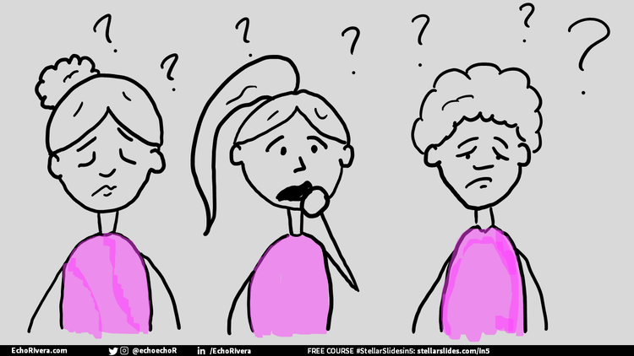
“Because this is your audience when you just go on babbling………”

Slide 4
You see more “lightbulbs” in the audience (and less confused or frustrated faces)

Slide 5
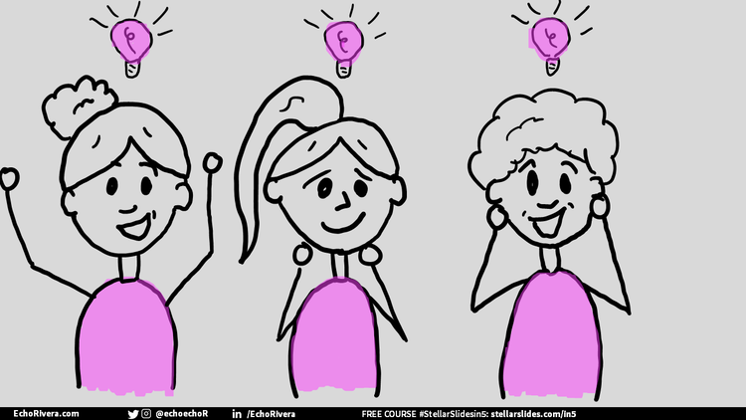
“ And this is your audience when they have something visual to see that helps them to understand your words….”

Slide 6
Your audience will be more likely to get excited about the topic

Slide 7
You’ll be able to share difficult information more effectively (rather than in ways that turn people away)

Slide 8
You become more excited to deliver your presentation!

